Slide 1
TA 101A:2019-20:II Lecture 23 – Normal Views of Oblique Surfaces-II
Dr. Bharat Lohani
Professor, Geoinformatics
Department of Civil Engineering
IIT Kanpur, Kanpur
Office: WLE 113
Phone: 7413
Email: blohani@iitk.ac.in

Slide 2
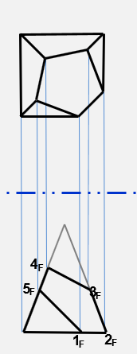
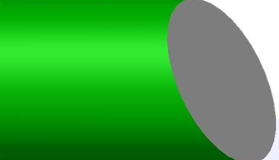
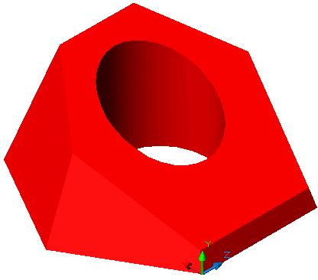
Recapitulation
Oblique Plane > Oblique Line > TL > PV> EV > TS
Normal view of oblique surfaces – some examples
D
E
C
E’
F
B
A
B’
F’
A’

Slide 3
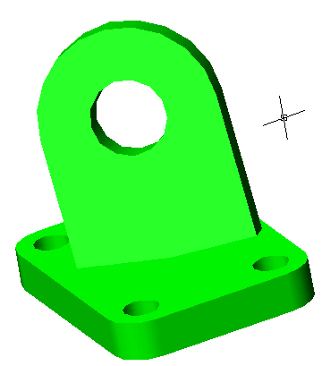
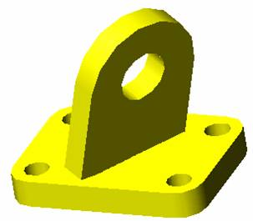
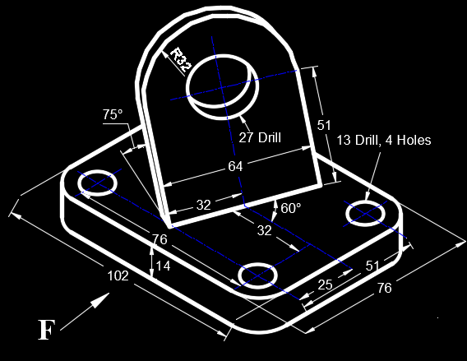
Example 1-Normal View of Oblique Surface
Draw F, H, and normal views of oblique surfaces in given object
A1
H
A1
A2
H
F

Slide 4
Example 2-Normal View of Oblique Surface
Given partial auxiliary views (containing true shapes of the faces), draw the frontal, horizontal and profile views of the object
10
40
10
10
φ20
20
20
60
40
40

Slide 5
Example 2-Normal View of Oblique Surface
6
5
4
3
2
H
1
F
F
φ20
A1
20
3
2
4
1
5
6
40
F
A2

Slide 6
Example 2-Normal View of Oblique Surface
φ20
20
40

Slide 7
Example 3-Normal View of Oblique Surface
20
10
40
20
10
10
15
30
30
30
45
40
10
40
20
30
20
40
30
30
10
20
30
10

Slide 8
10
20
Example 3-Normal View of Oblique Surface
40
20
10
10
15
30
30
30
45
40
10
40
20
40
30
20
30
30
10
20
30
10

Slide 9
Example 3-Normal View of Oblique Surface

Slide 10
Thank you !

